Slide 1
ESP8266 Node MCU
Introduction
Pinout
Working

Slide 2
Why ESP8266??
Other methods to connect to wifi:
1) Arduino(Microcontroller) + Wifi-Sheild (Rs. 4500)
2) CC3000 Wi-fi( Rs. 2400)
3) ESP8266 ( Rs. 250-400)
4) ESP8266 Node MCU ( Rs. 300-400)

Slide 3
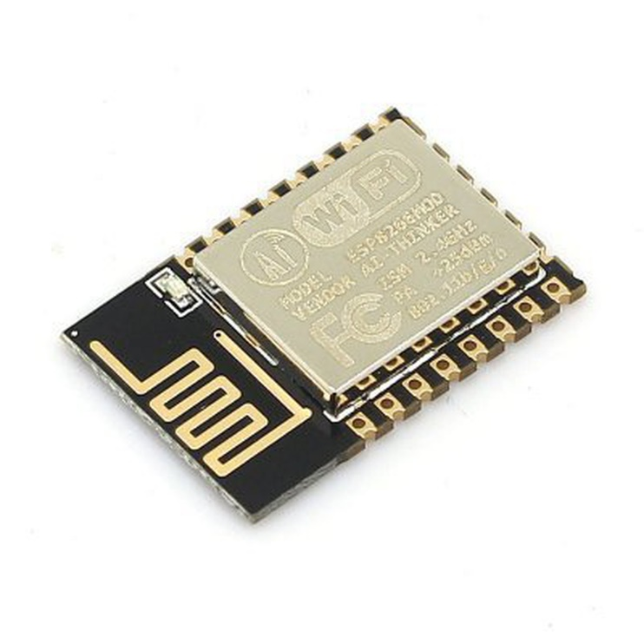
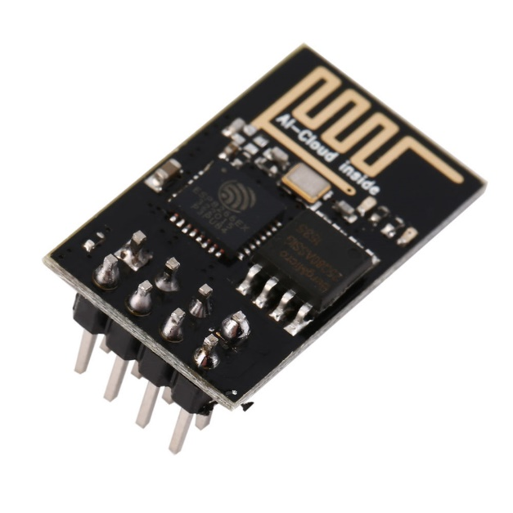
ESP8266
The ESP8266 is a low cost Wifi chip from Espressif, that you can use with your Arduino (for example) or even use it in standalone
This small module allows micro-controllers to connect to a Wi-Fi network and make simple TCP/IP connections.

Slide 4
What is Node MCU?
The NodeMCU is the name of a micro controller designed by Espressif Systems. The ESP8266 itself is a self-contained Wi-Fi networking solution offering as a bridge from existing micro controller to Wi-Fi and is also capable of running self-contained applications.
This module comes with a built in USB connector and a rich assortment of pin-outs.
With a micro USB cable, you can connect NodeMCU devkit to your laptop and flash it without any trouble, just like Arduino. It is also immediately breadboard friendly.

Slide 5
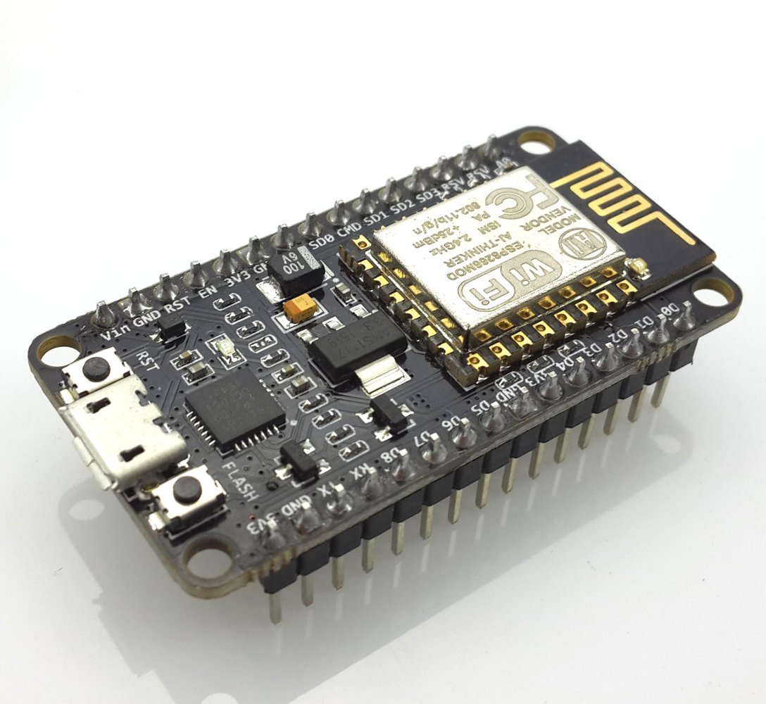

Slide 6
An open-source firmware and development kit that helps you to prototype your IOT product.
Simple ESP8266 can only be used to connect other micro-controllers like Arduino to internet with its inbuilt wi-fi chip. But with Node MCU development kit this hardware module can use its GPIO pins to connect to other peripherals without help of any other micro-controller.
That means you can program NodeMCU to work with other devices using GPIO along with connected wi-fi.
This make NodeMCU ideal for use in Iot projects. These can be programmed and then connected with other hardware like relays, buttons etc via GPIO and also to wi-fi. Over wi-fi they can contact with some more powerful machines like RaspberryPi using protocols like MQTT.
Using wi-fi these nodes can transfer states to main machine located on network or some sort of server. Server/Main machine can also issue commands to these nodes which they can perform as per their programming.

Slide 7
Specification:
• Voltage: 3.3V.
• Wi-Fi Direct (P2P), soft-AP.
• Current consumption: 10uA~170mA.
• Flash memory : 4MB, total attachable 16MB max (512K normal).
• Integrated TCP/IP protocol stack.
• Processor: Tensilica L106 32-bit.
• Processor speed: 80~160MHz.
• RAM: 32K + 80K.
• GPIOs: 17 (multiplexed with other functions).
• Analog to Digital: 1 input with 1024 step resolution.
• +19.5dBm output power in 802.11b mode
• 802.11 support: b/g/n.
• Maximum concurrent TCP connections: 5.

Slide 8
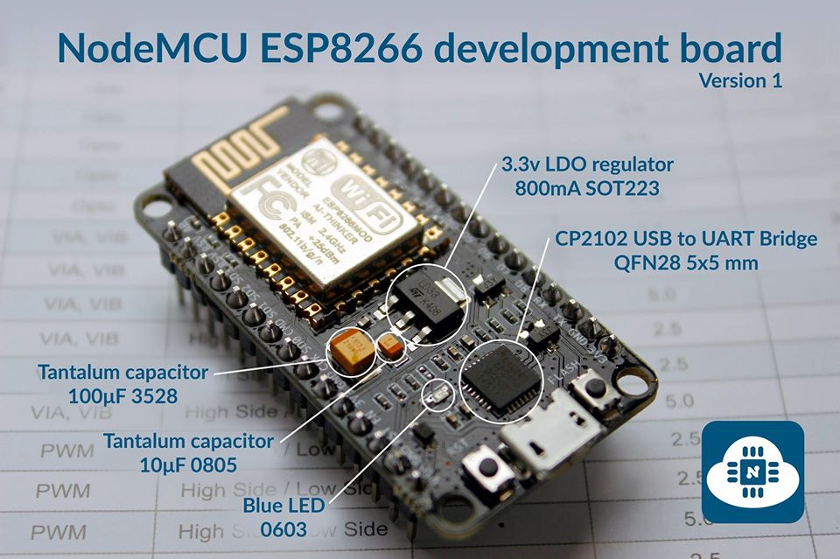

Slide 9
Node MCU Hardware:
ESP8266 : It is main chip which with inbuilt w-ifi
USB to UART convertor : This chip will convert USB data to UART(Universal Asynchronous Receiver-Transmitter) data which main chip can understand
Voltage regulators: Converts input voltage to 3.3V.
Status LED : This LED is basically used to show current status like flashing/booting
MicroUSB port : Connect board to Computer for programming and powering the board.
Reset/Flash buttons : Perform actions on board.
GPIO pins : To connect board with other peripherals.

Slide 10
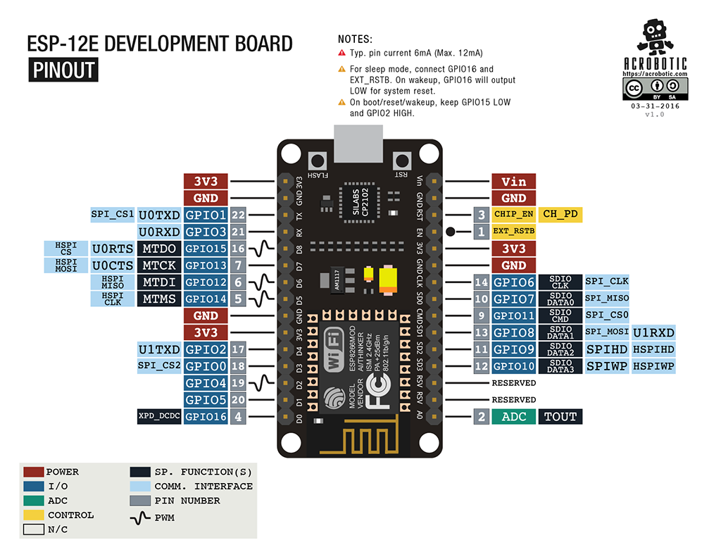

Slide 11
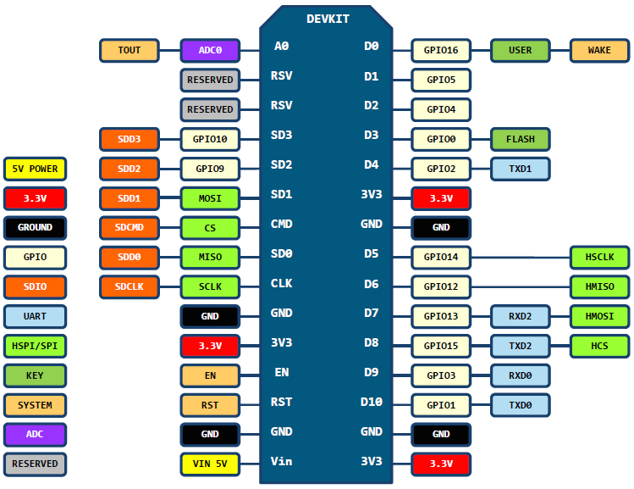
Pin Definition

Slide 12
Using Node MCU with PC
1) Install Arduino IDE.
2) Edit board manager URL for specific board.
a) File -> Preferences -> URL for additional board.
3) Install Board Library in Arduino IDE:
a) Tools -> Board -> Boards Manager -> Install ESP8266 boards.
4) Install Driver for USB Cable:
a) Device Manager -> USB Port
5) Select the required board and COM port.
a) Board: NodeMCU 1.0(ESP-12E Module)
b) Port: Select the available COM

